Slide 1
Employee Data Analysis using Excel
STUDENT NAME: A.ARSHU
REGISTER NO: 312208917
(CF8D493F0C41A459C7A48E4AD26ED7F3)
DEPARTMENT: B.COM ( GENERAL)
COLLEGE : CHEVALIER T. THOMAS ELIZABETH COLLEGE FOR WOMEN

Slide 2
PROJECT TITLE
Employee Performance Analysis using Excel

Slide 3


AGENDA
Problem Statement
Project Overview
End Users
Our Solution and Proposition
Dataset Description
Modelling Approach
Results and Discussion
Conclusion
3/21/2024 Annual Review

Slide 4

PROBLEM STATEMENT
A statement of work is used as a formal document that states the complete scope of work in a specific project. It states the duration of the project and explains what the deliverables and acceptable standards are, for a better understanding of the people involved. It serves as a binding contract between two parties just to make sure there will be no disputes and other unclear matters in the project

Slide 5

PROJECT OVERVIEW
.The overview of the project
This project contain about the data of the employee and the co-workers of the organisation
It contains of count of employees
The count of the employee type
Types of the employee work
Types of the department
Gender of the employees
Employees analyst

Slide 6
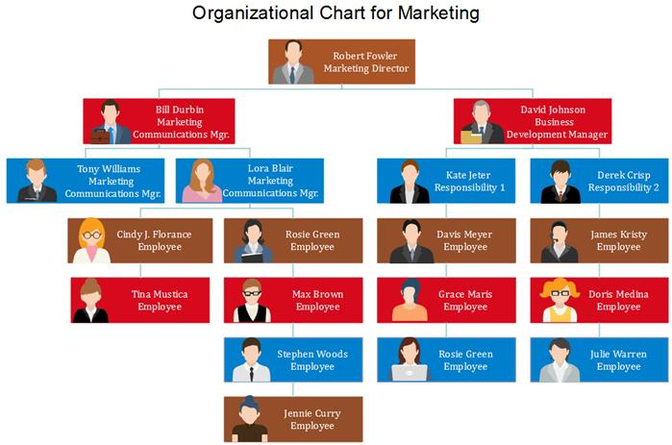

WHO ARE THE END USERS?

Slide 7

OUR SOLUTION AND ITS VALUE PROPOSITION
Conditional formation – missing values
Filter – remove the wrong value
Formula – performance
Pivot – summary
Graphic – data visualisation
Additional data analysis

Slide 8
Dataset Description
Employee data set- Kaggle
There are 26 features
The important ten features are,
Employment ID
First name
Last name
Gender
Employee status
Employee type
Employee classification
Performance score
Current employee ratings
Business units

Slide 9

THE "WOW" IN OUR SOLUTION
Performance Level– These include the categories such as Levels in very high, high, medium, low, etc...
3/21/2024 Annual Review
9

Slide 10
MODELLING
The modelling in this employee performance analysis project includes the following:
*Data collection
*Data cleaning
*Results
*Pivot table
*Chart
10

Slide 11
RESULTS
11

Slide 12
conclusion
The conclusion is the employee data analysis reveals the key insights in workforce performance and areas needed for improvement. The effective data analysis provides a foundation for the improvised planning and operational developments, which leads to a motivated and productive workforce environment.

